Slide 1
Bamboo Based Livelihoods
Dr AK Bhattacharya, IFS (R)

Slide 2

Bamboo based sustainable development solutions
For
Post COVID Crisis Mitigation
at Community level
Notes:
In the present scenario of global COVID crisis, I look at bamboo as a potential solution for post covid crisis mitiagation at community level.

Slide 3
Post Corona Crisis Issues
Living with Virus
3 Es solutions – Employment (livelihoods); Entrepreneurship (Jobs / Occupations); Enterprise (Businesses)
Communities will be worst affected
Scope / Solutions
  Local – Vocal – Global (Think locally – act locally – promote globally)
  Atm Nirbhar Bharat Abhiyan – Self Reliant India Mission
  Bamboo Chain of Custody in place –
    Natural resource – Human Resource – Technology - Market
Notes:
WHO & other experts indicate that now we have to find solutions to live with the virus. Bamboo can provide the 3 Es solutions to combat this crisis - Employment (livelihoods); Entrepreneurship (Jobs / Occupations); Enterprise (Businesses). For Indian Prime Minister’s vision of Local – Vocal – Global & Self Reliant India Mission, bamboo is the most appropriate commodity. The entire chain of custody – the natural resource, bamboo; the human resource, the artisans; technology, machinery & tool; and the market, are in place, just a trigger is needed.

Slide 4

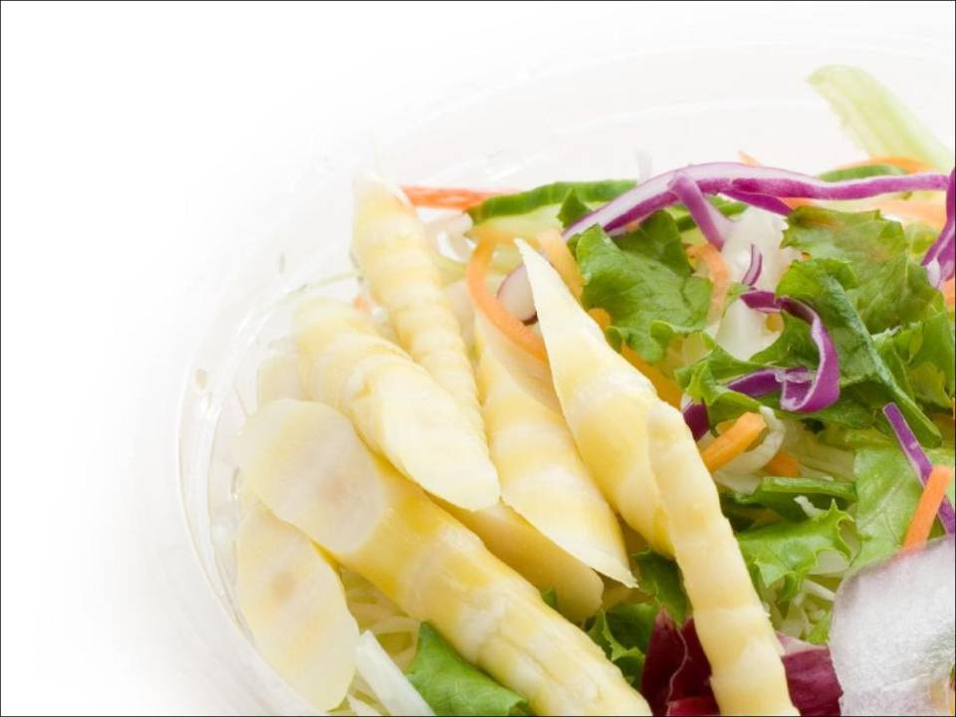
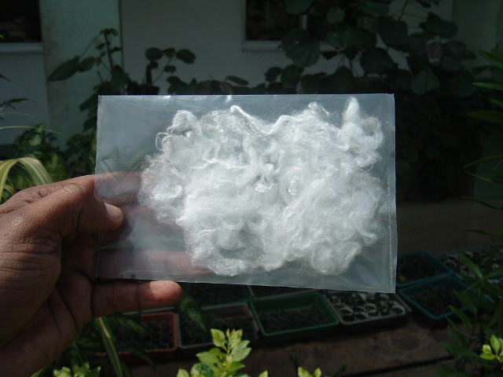
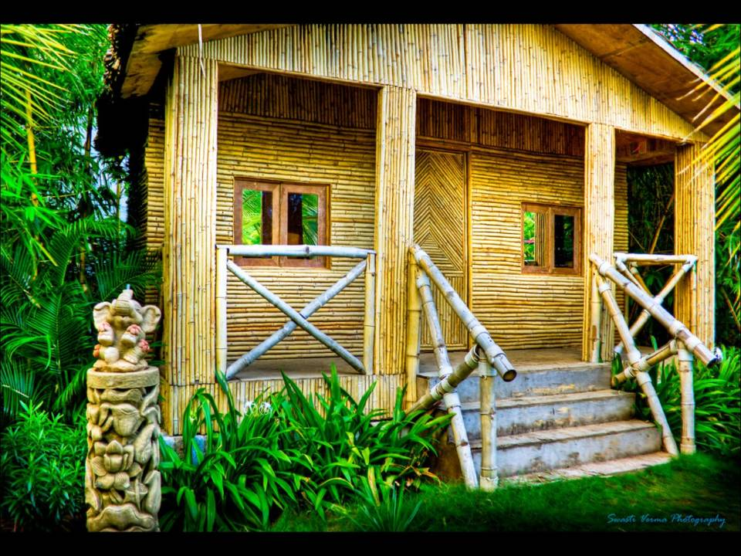
Bamboo – The versatile wonder
One product for three basic human needs
Clothe
Food
Shelter
Notes:
The versatile bamboo provides all basic needs for human existence – Food, clothe & shelter

Slide 5
Bamboo
Green Gold
Blue Gold
Notes:
A worldwide transition to a low-carbon, resource-efficient Green Economy will not be possible unless the seas and oceans are a key
part of these urgently needed transformations. The world’s oceans and coasts – the Blue World – are the cornucopia for humanity. They
provide us with food, oxygen and livelihoods.

Slide 6

Blue Economy
The Blue Economy permits to respond to the basic needs of all with what we have. As such, it stands for a new way of designing business: using the resources available in cascading systems, where the waste of one product becomes the input to create a new cash flow.

Slide 7
Human capital – Nutrition from shoots, Skill upgradation of artisans
Natural capital –
Environmental services,
Bamboo briquettes
Financial capital –
Income from bamboo products,
Boost to local economy
Physical capital –
Housing infrastructure,
Low cost toilets
Social Capital–
Bargaining power,
Traditional Knowledge
Vulnerability context
Resistant to seasonal changes
Less fluctuations in demand
Policy support/
Intervention required for bamboo and artisans dependent on it
Livelihood assets
Bamboo in the sustainable livelihood framework
Notes:
Sustainable livelihood framework - ifad

Slide 8
Bamboo Based Livelihoods: Scope
Single hectare of Bamboo with 500 Clumps
384 days of unskilled labor
48 days of supervisory work
Over a period of 30 days
Notes:
It is estimated that a single hectare of bamboo plantation with 500 clumps can generate 384 days of unskilled labor work and 48 days of supervisory work over a period of 30 days (Tiwari, 1992)

Slide 9
Sources Of Employment
Jobs!!!
Placements…!!
Employment..!!
Common facility Centres (14)
Bamboo Emporiums
Bamboosetums / Nurseries
Private Farmlands/ Entrepreneurs (through PPP mode)
Bamboo Training Centre “Centre of Excellence”
Bamboo Marts (6/year)
Bamboo Housing / Pavilions
Bamboo Producers’ Co.

Slide 10
Bamboo based livelihood diversification options
Traditional Bamboo based livelihood | Potential alternative source of livelihood
Bamboo crafts – Unorganised | Bamboo cottage industry – Organised Mats to mat Boards
Bamboo for fuel – Sustenance basis | Bamboo charcoal – Commercial basis Bamboo Biochar
Traditional agricultural crops – Vulnerable to climate | Bamboo crops – Diversification of risks from traditional farming
Traditional bamboo houses – Focus on shelter to those who are resource challenged | Modern bamboo houses solution – Focus is on providing affordable, timely and aesthetic bamboo architecture.

Slide 11
Bamboo Based Livelihood
Bamboo Farming Products Industry
(Baskets, green houses, fences)
Bamboo Food and Beverage Industry
(Bamboo shoots, bamboo wine, bamboo pickle)
Bamboo Bio-energy Industry
(Bamboo briquettes, bamboo charcoal, biochar)
Bamboo wood industry (poles, stripes, bamboo mat boards, veneers)
Building Industries- (Bamboo engineered housings, bridges, furniture, roads)
Bamboo Textile Industry (clothing, diaper, sanitary napkins)
Bamboo pulp and paper Industry (newspaper, bond paper, cardboard)
Bamboo Craft Industry (Handicrafts, toys, jewelry, utility handicraft items, etc

Slide 12
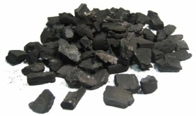


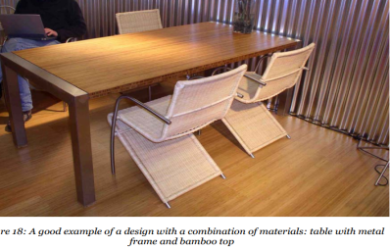


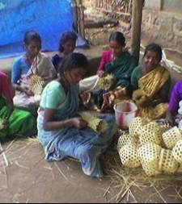
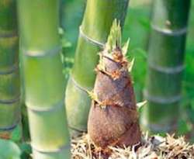
Bamboo based Economy
Bamboo
Economy
Farming
Bio-energy Industry
Furniture industry
Building Industries
Pulp & Paper Industry
Textile Industry
Craft Industry
Food and Beverage Industry

Slide 13
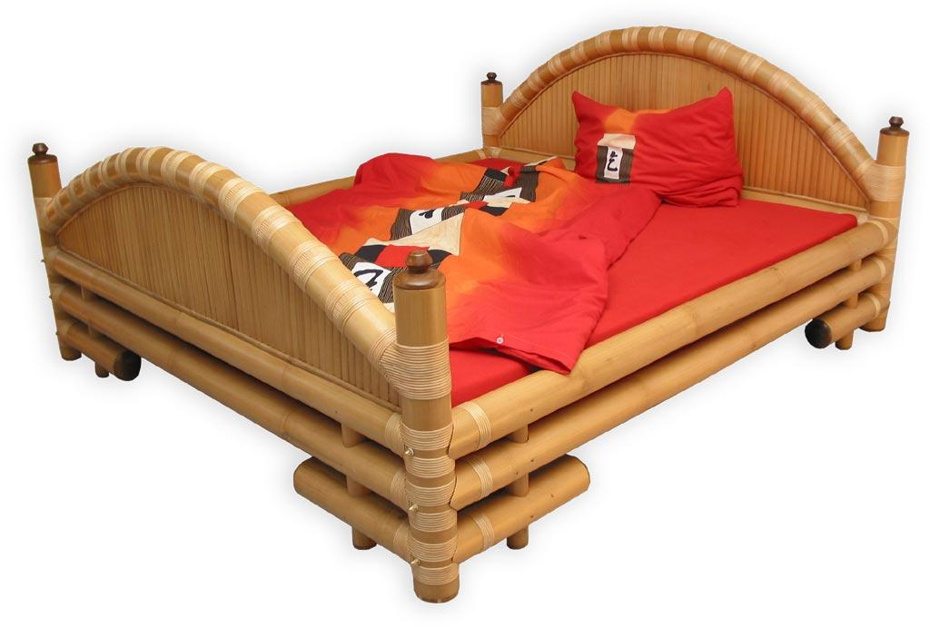
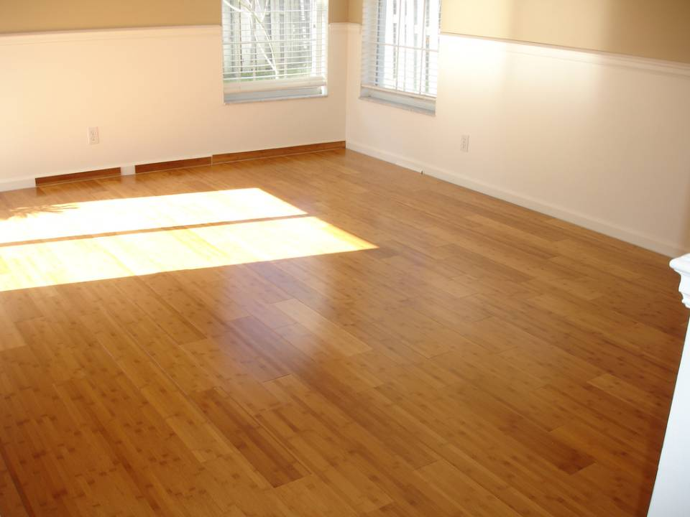
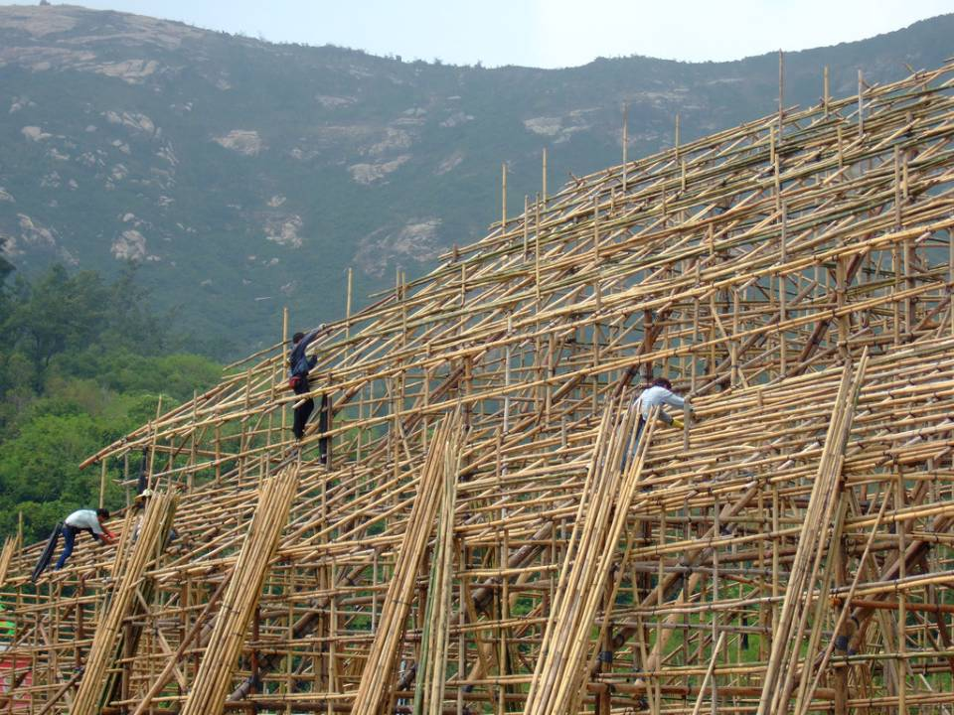
Potential economic contribution of bamboo
Bamboo Furniture - 3625 Crore
Bamboo Shoots- 300 Crore
Bamboo Flooring- 1950 Crore
Bamboo Pulp- 2088Crore
Bamboo Houses - 1163Crore
Bamboo Scaffolding – 816Crore
Notes:
http://www.tradingeconomics.com/india/gdp – 1876.8 trillion dollar
Planning commision and NMBA 2013

Slide 14
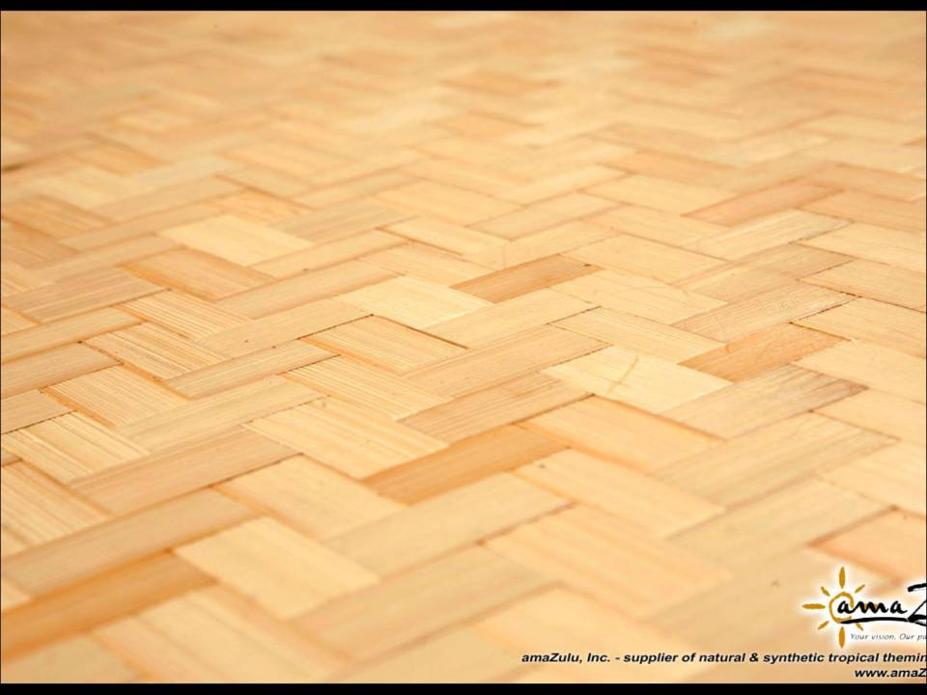

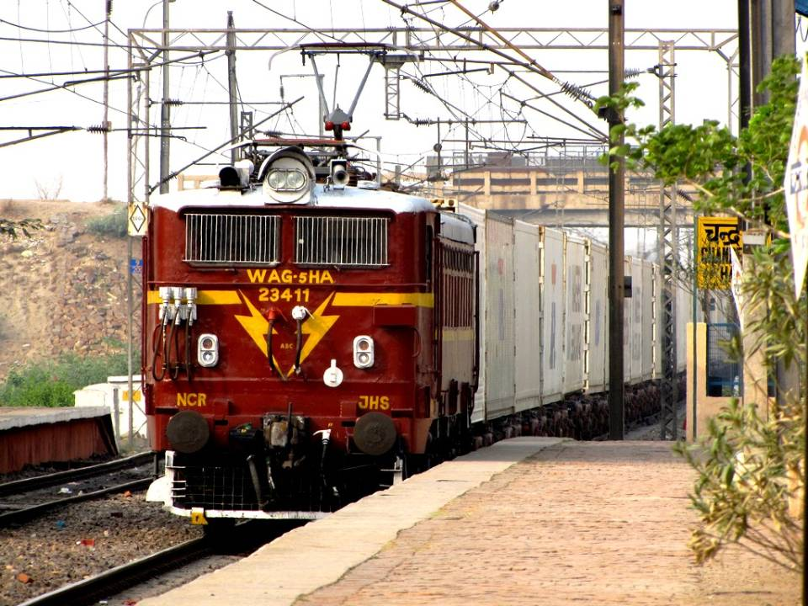

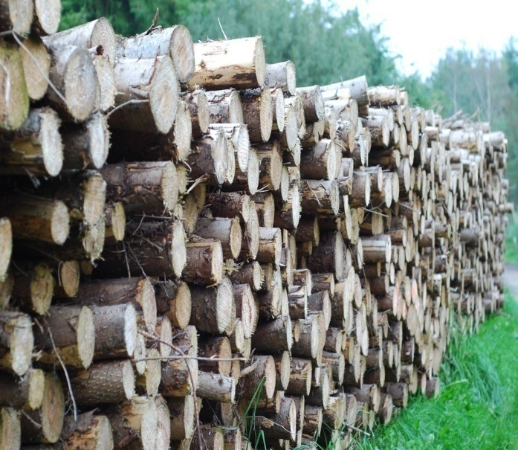
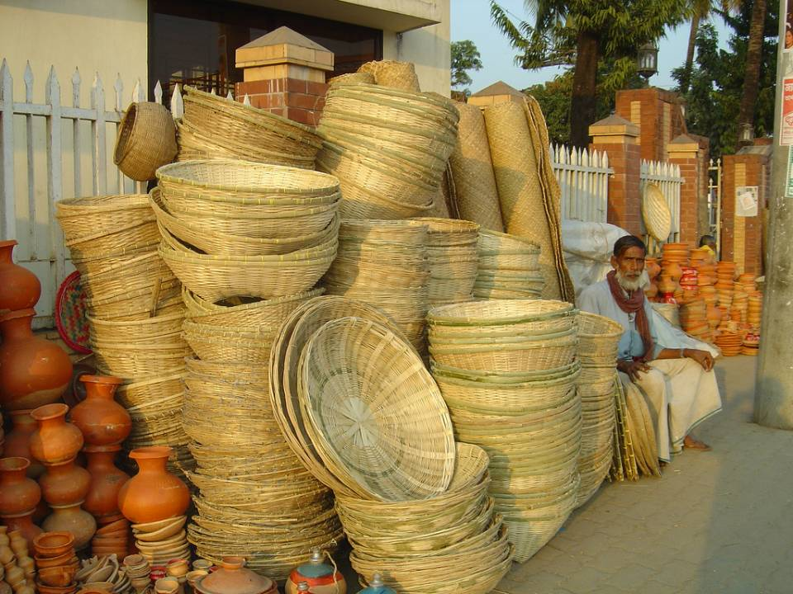
Potential economic contribution of bamboo
Bamboo Shoots- 300 Crore
Bamboo Incense Sticks – 300 Crore
Railways - 3408 Crore
Bamboo for road - 274 Crore
Wood substitute – 274 Crore
Miscellaneous - 300 Crore
Notes:
http://www.tradingeconomics.com/india/gdp – 1876.8 trillion dollar
Planning commision and NMBA 2013

Slide 15
Integration of Bamboo in various federal flagship programs
Make in India
Higher yield per hectare than cotton and timber.
Timber substitute in furniture, houses, railways
Clean India
Cost of a bamboo toilet – Rs 14,000
Lasts for 35-40 years
Housing Mission
Tensile strength of bamboo – 350-500 Mpa (> mild steel)
Rs 1.25 lakh per house of 400 sq ft
Inclusive Growth
Green India Mission
1.5 million Ha forest is degraded every year
Social inclusion – Parity of wages of 43% women artisans
NBM can converge with GIM for afforestation target of 5 m Ha
Financial inclusion – Plantation can generate 97.2 m man days ~ 4860 m wages earning in cottage industry annually
Notes:
http://agritech.tnau.ac.in/forestry/forestry_faq_bamboo.html
https://www.nabard.org/pdf/BAMBOO.pdf
http://www.fao.org/docrep/ARTICLE/WFC/XII/0757-A1.HTM

Slide 16
LIVELIHOODS & ENTREPRENEURSHIP OPPORTUNITIES IN BAMBOO SECTOR

Slide 17
Bamboo- Change Agent
Economical
Gender Equality
Social
Ecological
Energy
Lifestyle
Bamboo based
Sustainable Development

Slide 18
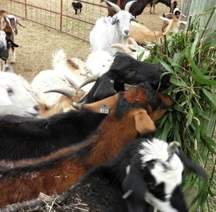
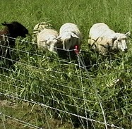
Bamboo leaves as fodder
Goats making a beeline for bamboo fodder
Sheep preferentially eating bamboo leaves

Slide 19
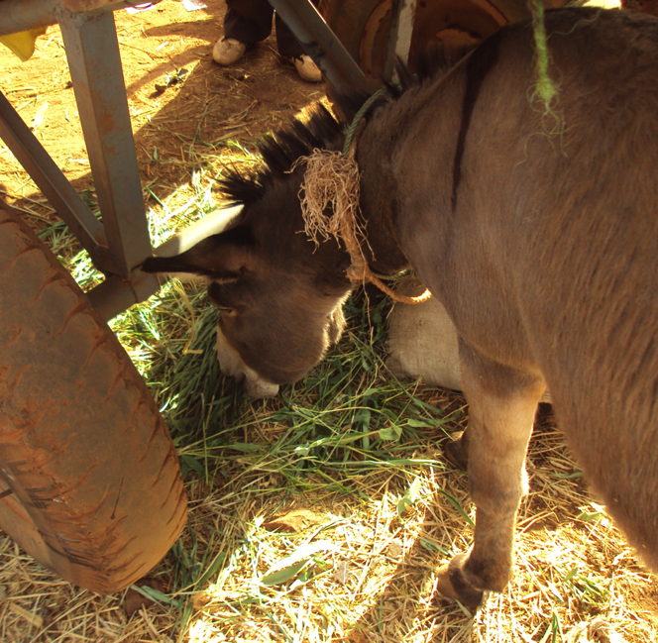
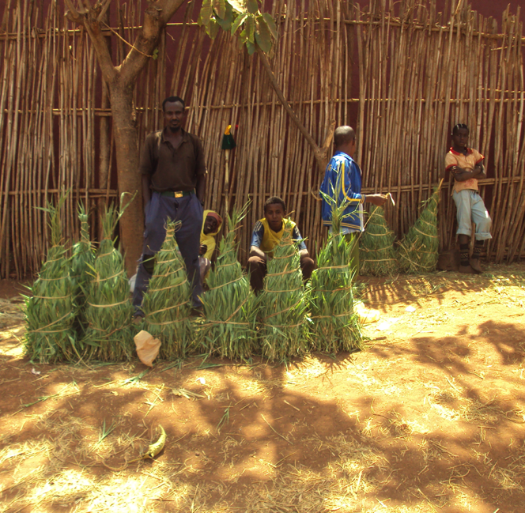
Donkeys are given bamboo leaves (Ethiopia)
Donkey eating bamboo leaves – commonly twice a day
Bamboo leaves are a commodity sold at markets

Slide 20
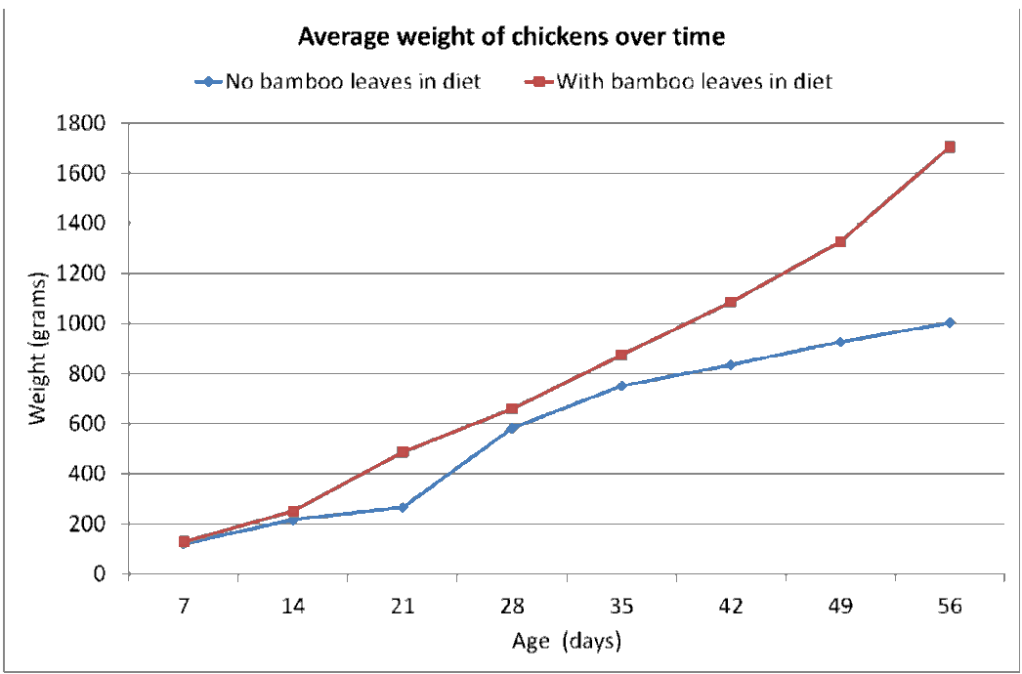
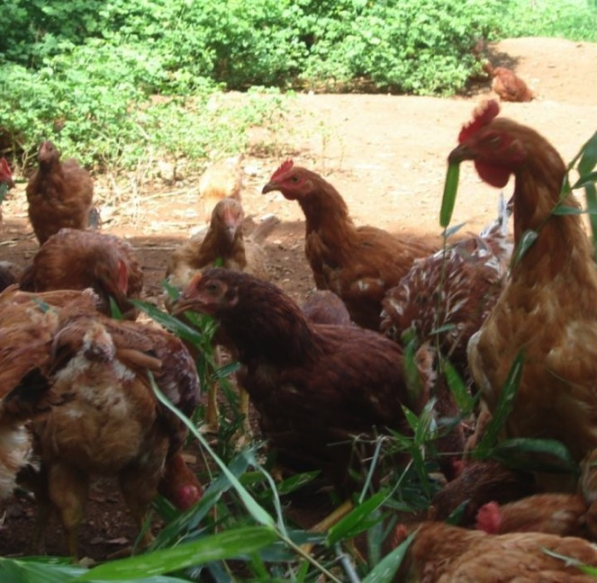
Bamboo leaves: feed for chicken
Chicken love bamboo leaves
Organic chicken gain 70% weight with bamboo leaves

Slide 21
Processing based livelihoods
Bamboo commodities in quantity – input material for quality products!
  Treated and graded bamboo
  Turned bamboo, squared bamboo
  Square and round sticks for agarbatties, pencils, matchsticks
  Slats for panel board
  Slivers for interlaced (“woven”) products
  Crushed bamboo and wafers for bamboo for panels

Slide 22
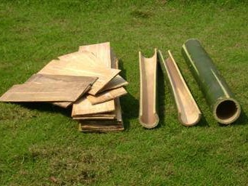
Flattening of bamboo > bamboo planks

Slide 23
Market based livelihoods
The more we mainstream bamboo as a material, the less would be the effort in greening the economy. That would also avoid deforestation.
Institutional markets, school furniture, school buildings, IAY housing, and others
Bamboo construction creates 90.9% rural jobs and 9.1% urban jobs! This compares well with the crafts sector, where 93.5% rural and 6.5% urban jobs were created.

Slide 24
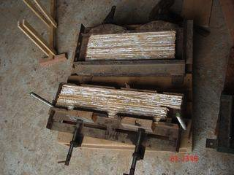
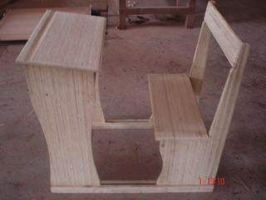
Panel production by rural communities
1-2 square m/HH/day
10,000 HH can produce 10,000 sq m/day, all above the poverty line!

Slide 25
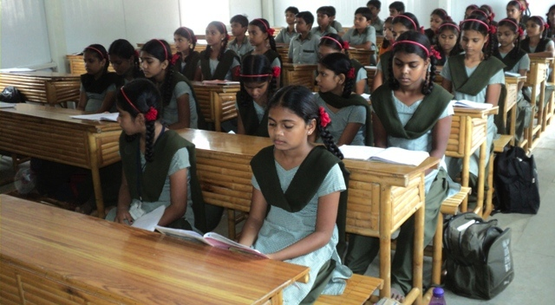
A Complete School Equipped with Bamboo Desks in Gujarat

Slide 26
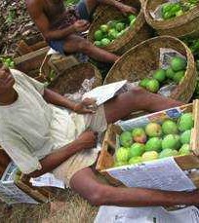
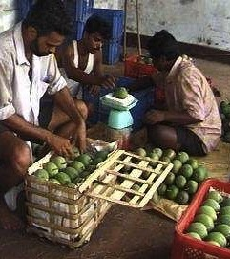
Bamboo Packaging
Notes:
26

Slide 27
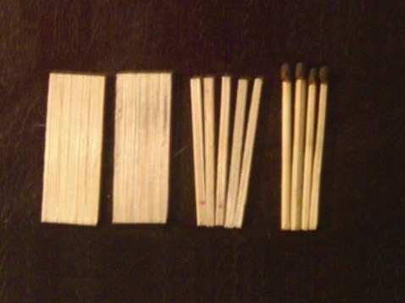
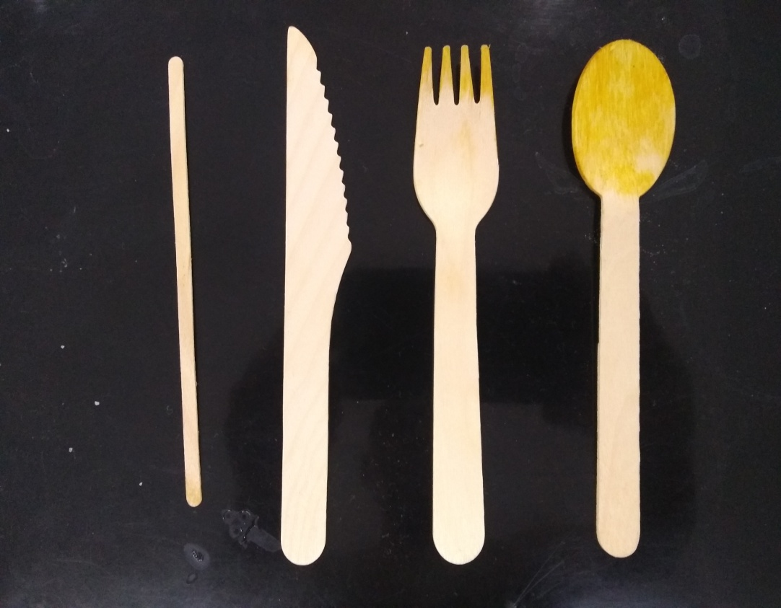
Bamboo Matchsticks
(Made in India)
Cutlery in Aircraft
(Made in India)

Slide 28
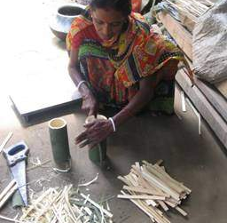
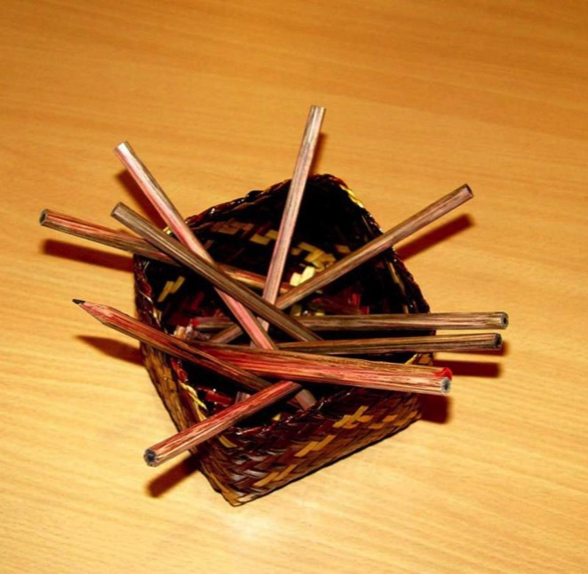
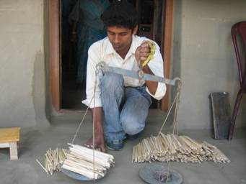
Bamboo Pencils
(Made in India)
Bamboo pencils
Notes:
28

Slide 29
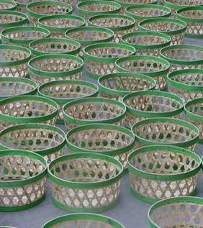
Handicrafts – baskets, mats
Quality & Scale; Value in Volume

Slide 30
Renewable Energy Rural Livelihoods
Food crops are perishable and susceptible to weather
Bamboo as energy crop is not susceptible to weather
Farmers = Food + Energy
(Biomass, Charcoal, Power)

Slide 31
Degraded & Wastelands based livelihoods
Bamboo rehabilitated tens of thousands of hectares of used brickfields - won the $1 million Alcan Prize for Sustainable Development (2007)
The 68 million ha of degraded land and 52 million ha of wastelands in India (total 120 mln ha) can similarly benefit
1% of 120 mln ha can benefit 1.2 million HH
Income: $0.46-$3.23/day at lowest yield of 10 tons/ha.

Slide 32
Carbon Capture and Storage (CCS) based livelihoods
121 million households (49% of population) use firewood
Household Charcoal from cooking (inorganic carbon)
  @ 10% yield; 44.6 million tons HHC; 164 million tons of CO2 Rs 54,000 crores
  @ 20% yield; 89.2 million tons HHC; 328 million tons of CO2; Rs 128,000 crores
  @ 30% yield; 133.8 million tons HHC; 496 million tons of CO2; Rs 182,000 crores
Bamboo forests also capture CO2 (organic carbon)
Position bamboo as a strategic resource to mitigate and adapt to climate change in the Paris COP.

Slide 33
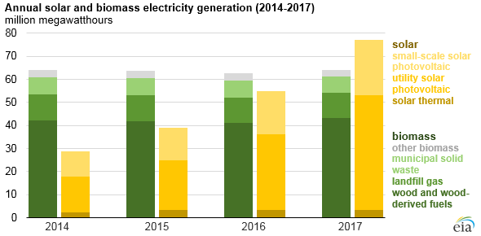
Biomass energy versus
Solar energy
Biomass
Solar
Generates income
Enhances resilience
Benefits the land
Powers HH
Powers enterprises
Local employment generation
Enhanced food & water security
No batteries. Optional since 24x7 power
Enhances expenditure
Enhances indebtedness
No benefit to the land
Lights HH
None that need power
No employment generation
No Recurrent expenditure on batteries

Slide 34
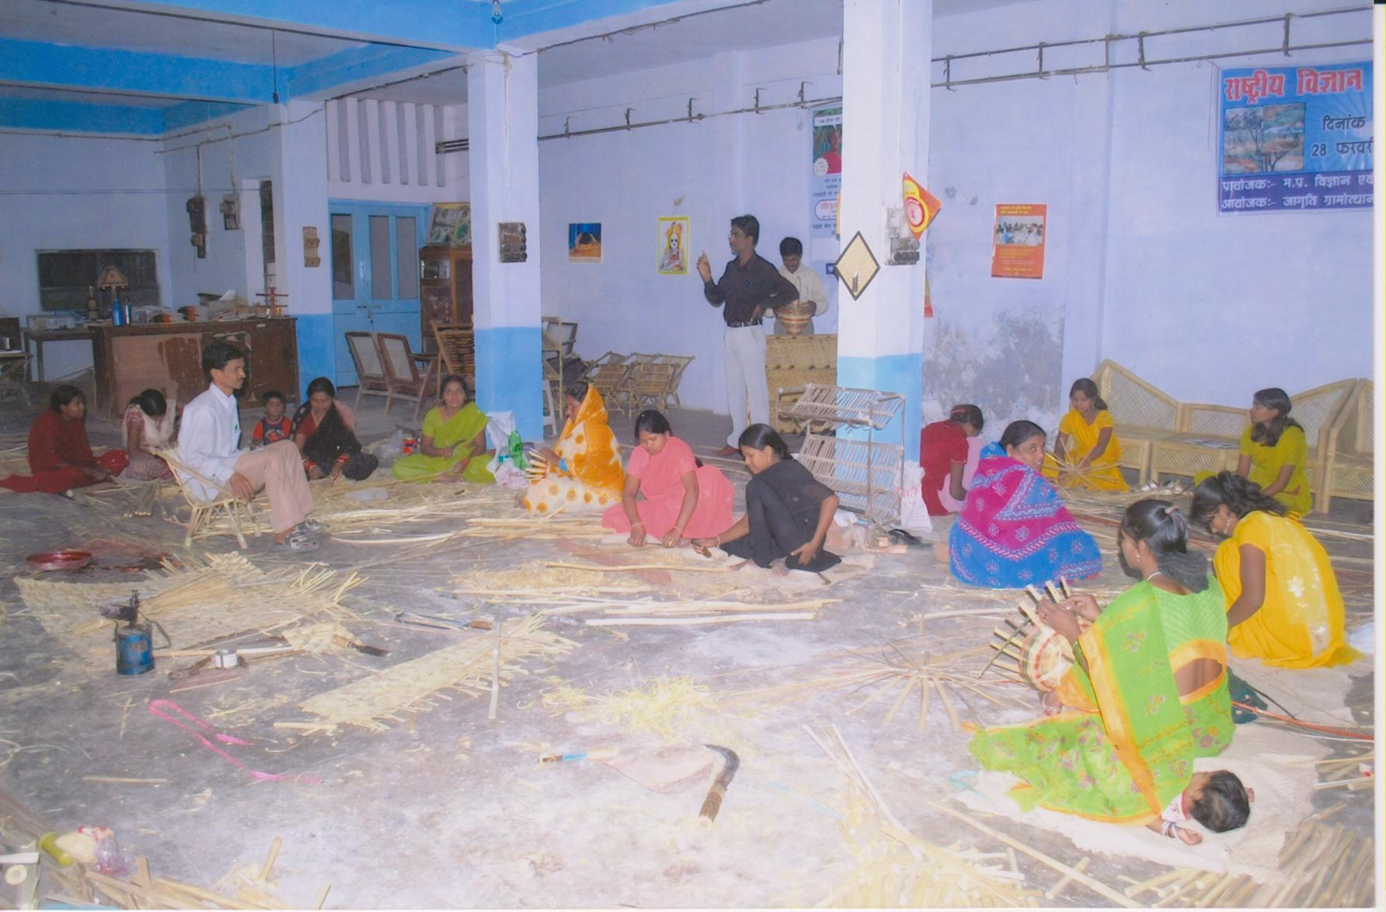
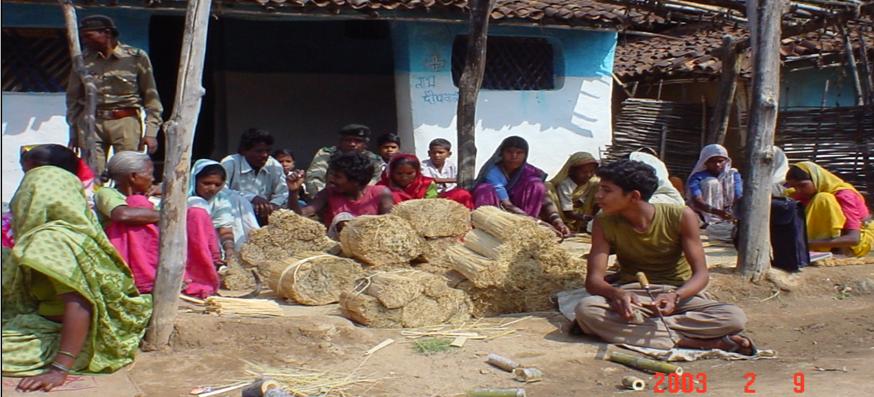
Community based High End Bamboo Enterprise
Bamboo based Sustainable Development

Slide 35
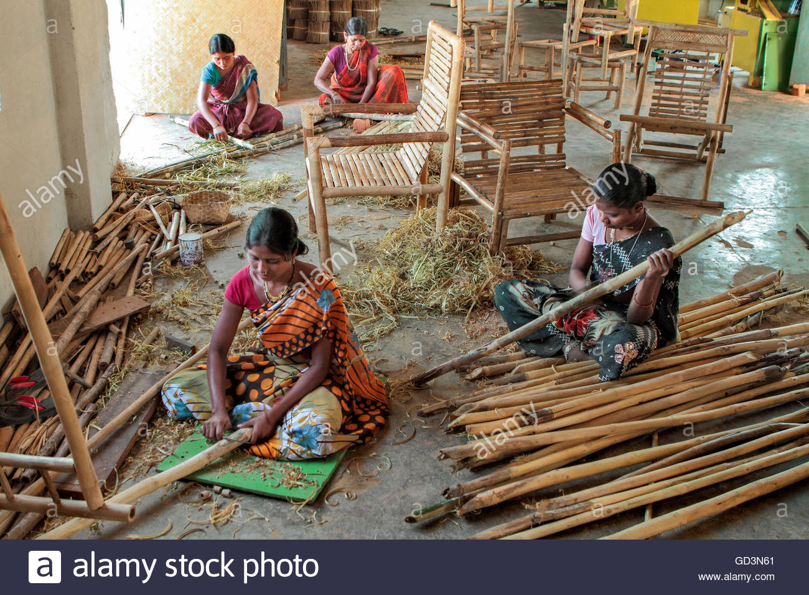
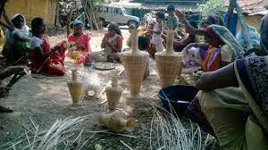
Community based High End Bamboo Enterprise

Slide 36
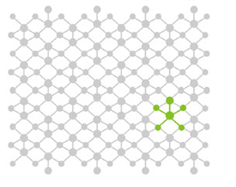
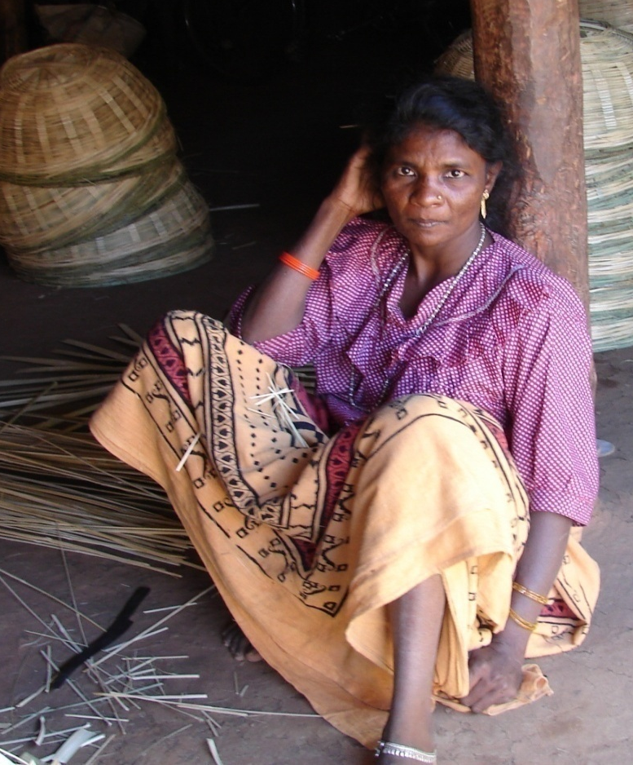
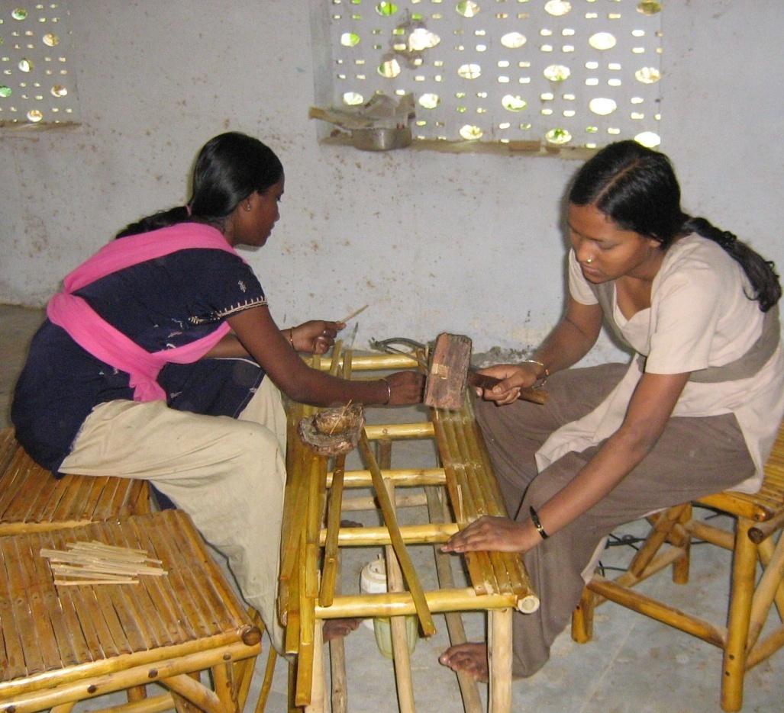

Sustainability design can help facilitate inclusive and sustainable development
PTG BPL Landless Marginalized Unsustainable craft economy
Bamboo based Sustainable Development

Slide 37
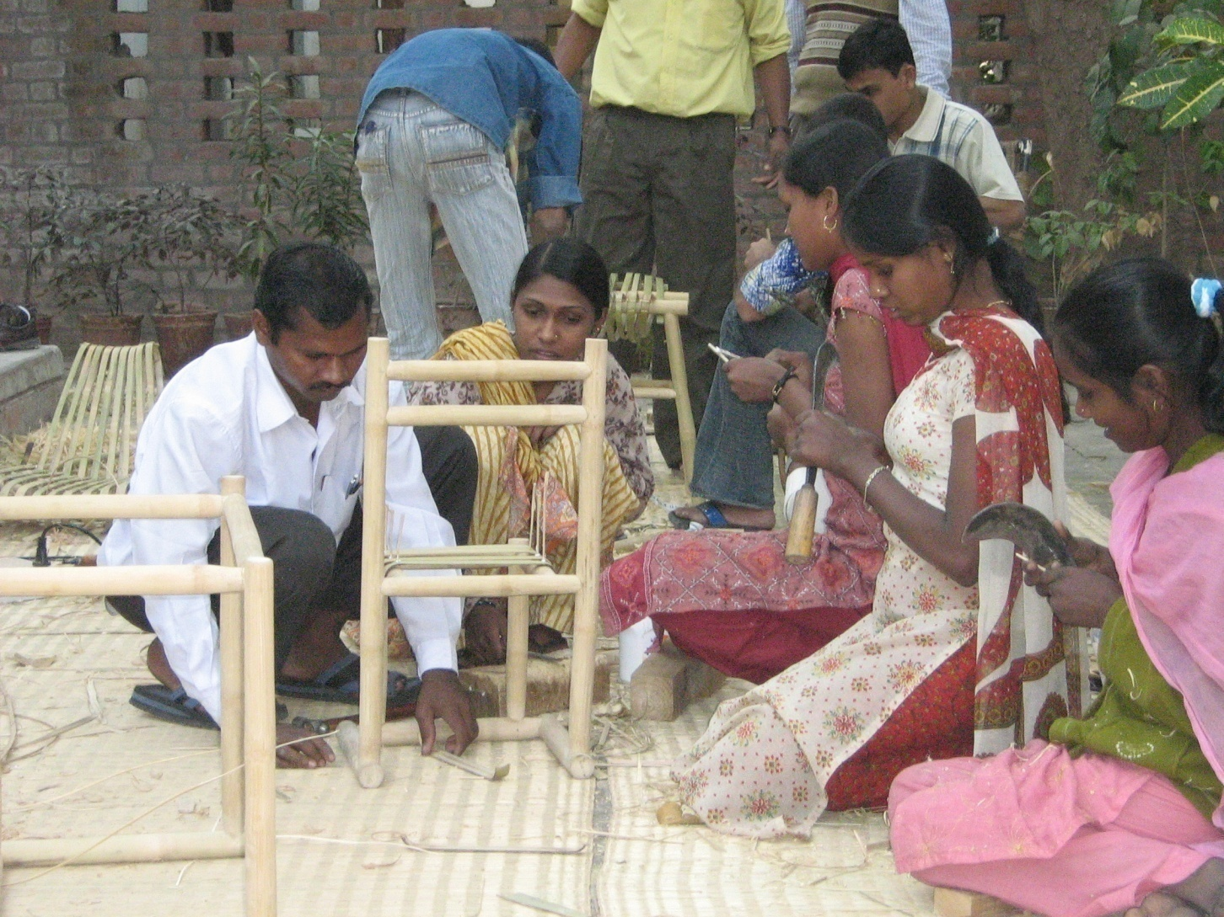
Sustainable and inclusive development by sustainability design
Bamboo based Sustainable Development

Slide 38
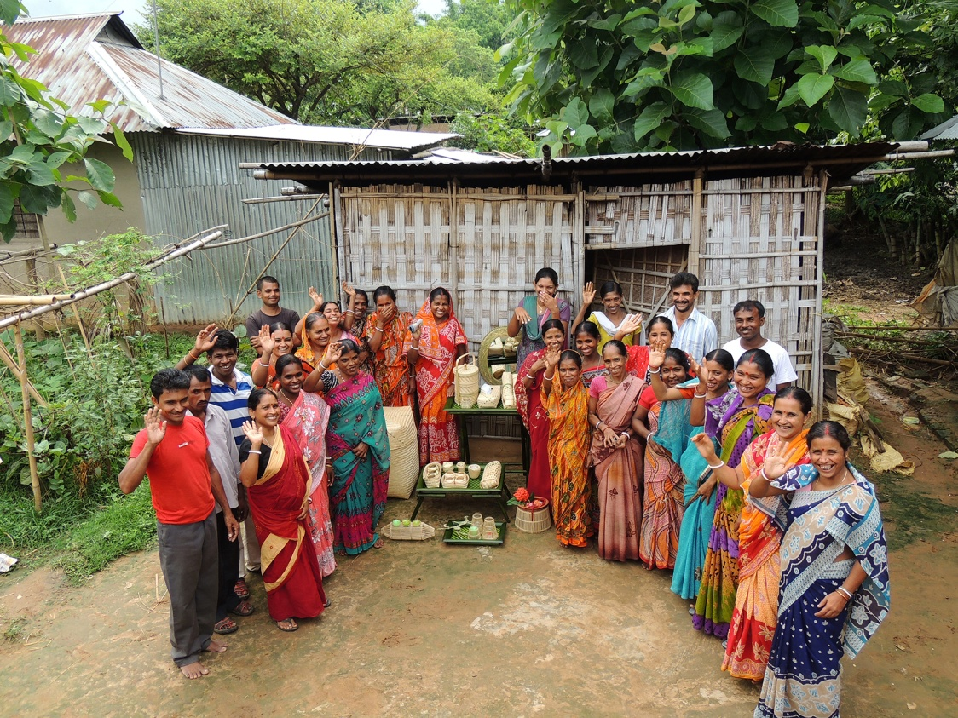
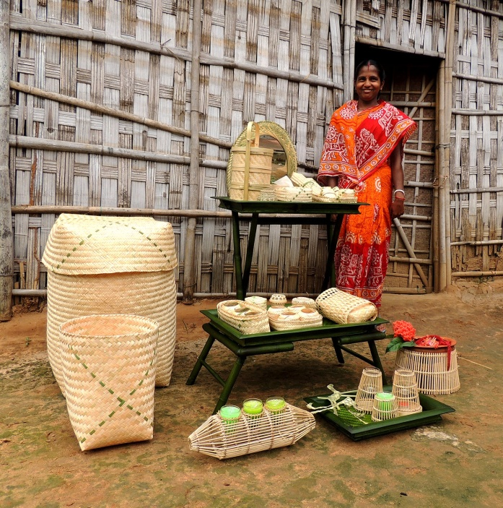
Not just telling the story…..
Full circle – return to design with Charilam cluster in Tripura
Bamboo based Sustainable Development

Slide 39
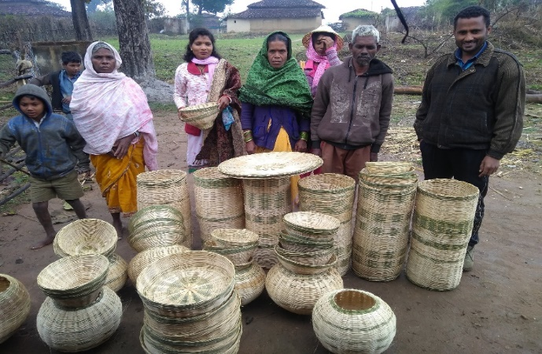
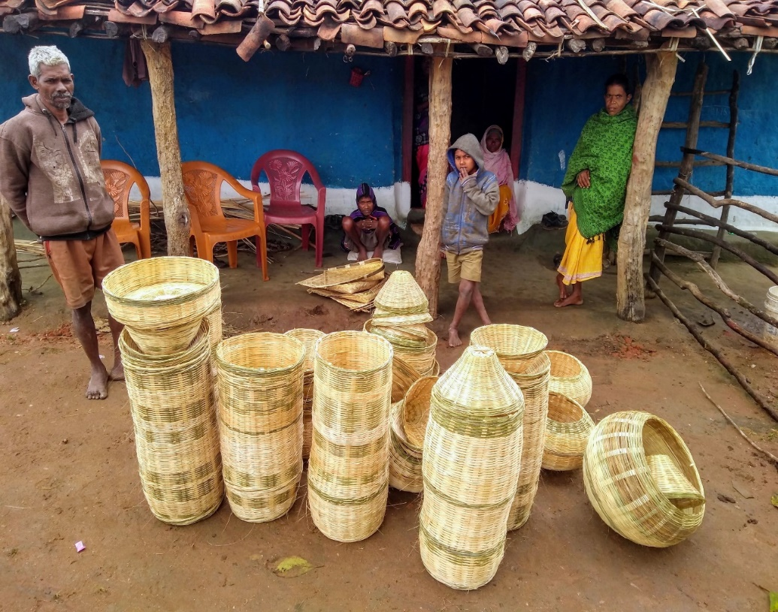
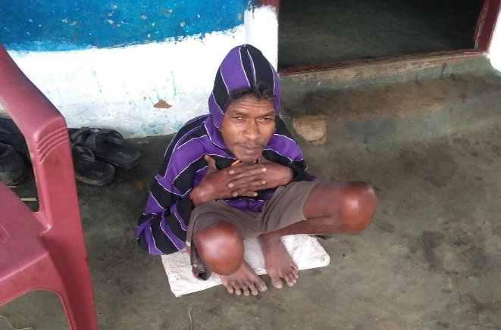
Fancy high-end lampshades made by PTG Baiga Tribe Artisans
The head artisan is physically challenged

Slide 40
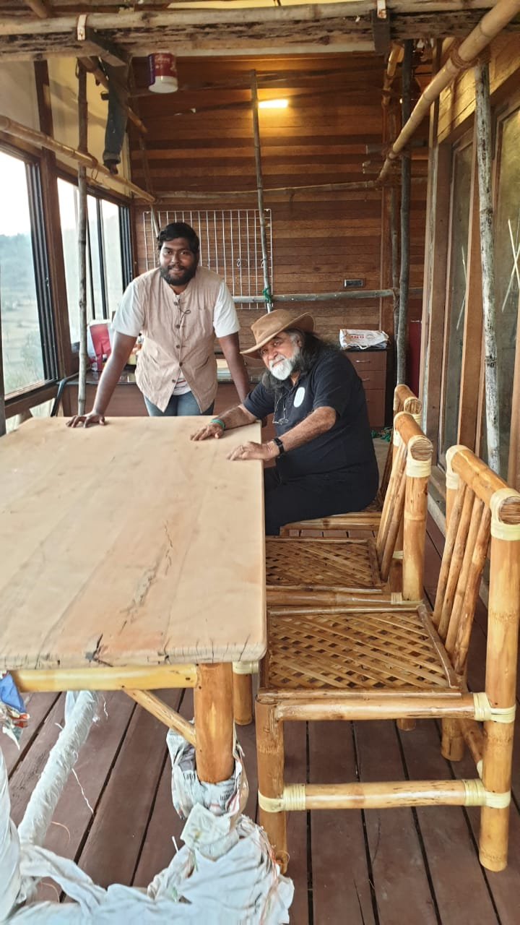
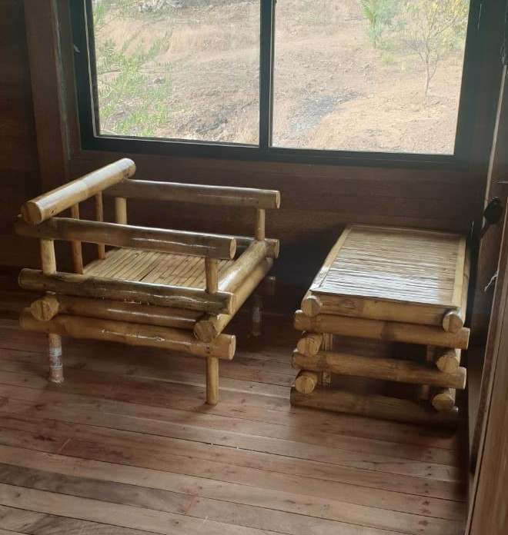
Bamboo into Bollywood
Film Producer Prahlad Thakkar Purchased Bamboo Furniture from Balaghat Bamboo Centre

Slide 41
Bamboo – a complete utility entity
Kerwa Bamboo Centre
  Bamboo blind / chik
    Agarbatti
      Briquettes
        Charcoal
          Power generation (gasification)
            (supply to mall thro’ dedicated grid)

Slide 42
Sustainable Marketing potential
Huge supply demand gap
Growers do not have market access
Potential buyers do not have resource access
– no idea of suppliers
Proposed web portal for growers / buyers

Slide 43
Potential of Bamboo Based Livelihoods
The Scenario in India
India has the World’s second largest Bamboo resource and the largest area under bamboo plants, with 136 species, 23 genera covering 13.96 million hectares (FSI, 2011).
Despite having largest area, India contributes to only 4% share of the global market – production 4.6 million Tonnes.
Employment for 50 million people can be generated worth Rs 26,000 Crore.
Bamboo has many advantages such as it has potential to create rural employment through bamboo craft-making, used as fodder for livestock and fuel-wood, construction material, bamboo shoots as vegetables and pickles and other ecological and religious importance.
In order to enhance livelihoods of forest dependent poor through bamboo based enterprise development conscious efforts are needed to promote bamboo-based community enterprises with back-up from support services.

Slide 44
Bamboo Based Livelihoods: Scope
It is estimated that a single hectare of bamboo plantation with 500 clumps can generate 384 days of unskilled labor work and 48 days of supervisory work over a period of 30 days (Tiwari, 1992)
An estimated 8.6 million Indians depend upon Bamboo for their livelihoods already (Planning Commission’s 10th plan document)
One hectare of bamboo plantation can produce 200 man days of employment and 900 man days in cottage industry with the raw material from this plantation (Lakshman, 1999).
Harvesting of bamboo from natural forests generate every year 2.25 million man days equal to Rs.112.5 million wage earning.
One billion people live in bamboo houses; 1000 houses are made every year in costa rica

Slide 45
Bamboo Based Livelihoods : Scope
Bamboo is a very versatile NTFP with a wide range of domestic, commercial and industrial uses.
Despite the great demand for bamboo and the products made from bamboo, its production today is far below potential.
 | Industrial bamboos to Industries (in lakh NT)* | Commercial Bamboo to Farmers (Nistar) and Basods (artisans)** (in crore nos)
Demand | 5.00 | 6.00
Supply | 0.50 | 0.55***
% age gap | 90.00 | 91.83
Supply Demand Gap of bamboo in MP

Slide 46
Potential of Bamboo Based Livelihoods : The Scenario in Madhya Pradesh
Bamboo, which is an important forest produce, has high significance in socio economic life of rural MP (P.B. Gangopadhyay; 0757-A1; XII World forestry Congress, 2003)
Madhya Pradesh has 20.3% of the area and 12% of the growing stock of Bamboo (Rai S N, 1998)
Madhya Pradesh ranks 15th in the country. 37.41% of the rural families live below poverty line, which is Rs. 15,000 annual income (HDR, 1998)

Slide 47
Main Consumers of Bamboo in MP
Basods
Basods are the people belonging to community of bamboo craftsmen who are traditionally dependent on bamboo for their livelihood
Nistari
The nistaris use bamboo for house repair and crop harvesting and other domestic uses.
Basods are poorest of the poor among the rural population.

Slide 48
Potential for Bamboo based Livelihood Development for Basods
Basod families on an average demanded 908 bamboos per family as against the actual receipt of 248 bamboos.
The average rate of bamboo was Rs.4.89* and after adding the transportation cost to their home the figure goes up to Rs. 5.89* per bamboo.
The net income per bamboo on an average was Rs. 15.83.
If Basods could be provided 908 bamboos per family as demanded by them or provided 1500 bamboo per family as per Nistar policy then 51.42% and 77.38% family would go above poverty line respectively.
If 917 bamboos per family could be provided then all the basod families would come above poverty line of Rs.15000 per annum.
This shows the strength of bamboo as a contributing factor for poverty alleviation.
(Source: Primary Survey results, Paper by P.B. Gangopadhyay; 0757-A1; XII World forestry Congress,2003)

Slide 49
Potential for Bamboo based Livelihood Development for Nistari
Nistaris got bamboo at the rate of Rs.3.62 per piece while the market rate of commercial bamboo was Rs.11. Thus an income supplement of Rs.7.38 per bamboo was provided to the families
Family income of the nistaris on an average was found to be Rs.17, 132 per annum. 72% of the 154 families surveyed were found to be below poverty line of Rs.15,000 per year.
If supply of bamboo could be increased to 167 bamboos, which was their demand and to 250 bamboos, which is the quantity as per nistar policy, the percentage of families who are living below poverty line will change from 72% to 69% and 66% respectively.
(Source: Primary Survey results, Paper by P.B. Gangopadhyay; 0757-A1; XII World forestry Congress,2003)

Slide 50
Madhya Pradesh State Bamboo Mission
MP Government constituted MP State Bamboo Mission (MPSBM) with Agriculture Department in 2007 and nominated Forest Department as nodal agency in 2009.
MPSBM has been registered as Society in July 2013. Hon Forest Minister is the Chairperson of the General Body and PS (Forest Department) is the Chairperson of Executive Body.
The Society shall function as the apex coordinating organization for the implementation of the activities of the National Bamboo Mission in Madhya Pradesh and / or any other project given to the Society for implementation.
MP State Bamboo & Bamboo Crafts Board is a constituent advisory body under Mission. The Chairperson of the Board, to be nominated by State Government, is the ex-officio Vice-Chairperson of the MPSBM

Slide 51
Bamboo Livelihoods Program under MPSBM
A bamboo based integrated livelihoods program shall be undertaken. The strengths and weaknesses of previous and on-going efforts will be meticulously analyzed for value addition and possibilities of new interventions will be explored and incorporated in the program. This program will be implemented in coordination and collaboration with all line Departments and Organizations.

Slide 52
Bamboo based Sustainable Development in Madhya Pradesh
(Win-Win Situation)
Extensive Bamboo Resource | 18167 Sq Km Bamboo cover Only 33% under Active Management of FD Potential Production - 4 lakh Ton (Present - 25%)
Skilled Human Resource | Strong Base - More than 20000 skilled Bamboo Artisans are available Artisans have been rated and ranked through NID & SPA. The process can continue
Strong Technical Support | 13 Bamboo CFCs in place (IPIRTI had agreed to convert these to state of art centres) These can be converted in theme-based Bamboo Centres for Excellence INBAR ToT model can be replicated
Huge Niche Market | Tourism Department (Furniture / Souvenir) Schools (Furniture) Bamboo Housing / Bamboo Timber / Bamboo Textiles Treated Bamboo Demand (10 lakh bamboo each year - INR 20 Crore)
Actions | State Bamboo Policy (Draft in place) State Bamboo Development Authority Implementation of INBAR Proposal Bamboo Investors Incentive Strategy Regular Bamboo Investor Summits Annual World Bamboo Summit
Bamboo based Sustainable Development in MP
Madhya Pradesh as the Bamboo Capital of India

Slide 53
Case Study - Sidhi
Sidhi District in Madhya Pradesh is a tribal dominated area is also known for its low development indices in terms of poverty, education, health and employment.
The unsustainable practices followed by the tribal population to harvest the forest produce and firewood from the forests of Sidhi has put tremendous biotic pressure on its natural resources.
To combat these problems, the Sidhi Forest divisions has established two common facility centers at the villages of Kolhudeeh and Gandhigram.
These common facility centers act as the training and processing centers for the manufacture of numerous products like bamboo based incense sticks, sheesal fiber ropes and its handicraft items, ropes from cloth shreds and Mahua based edible products.

Slide 54
Keeping in mind the following objectives, some amount of Bamboo was made available to the tribal women in the villages of Sidhi to manufacture of Agarbatti (incense sticks) at the two common facility centers:
1. Processing the bamboo available in the forest division and increasing its utility by value addition.
2. Stopping the unmindful harvest and destruction of forests by the women in the rural tribal forest division
3. Making the women self dependent and promoting women empowerment by their socio-economical development.
4. Promoting the trust and support in the forest department among the tribal community.

Slide 55
Results at Sidhi
At Gandhigram, 450 women initially were trained with the help of non-governmental organizations in this area and 20 women among them were further trained as master trainers. With the help of these master trainers 60 self help groups i.e. 600 women were trained further.
In the same pattern, the common facility center at Kolhudeeh has made over 2500 women self reliant thus decreasing the biotic pressure on the adjoining forests.
These tribal women today have stopped the collection of firewood and started manufacturing the incense sticks as a better means of earning their livelihood.
Today, the CFCs at these centers have over 4000 women engaged in production of incense stick from bamboo and similar products. They are making a turn over of about Rs 60 lakh per annum.

Slide 56
Training needs
The association of Bamboo with livelihood promotion in India remains confined to handicrafts promotion as a result of which even government programs fail to appreciate its industrial potential.
In addition, archaic and confusing regulatory regimes as well as conflicting legislation prevent Bamboo from reaching its true potential.
(Source : The bamboo industry in india supply chain structure, challenges and recommendations by Aniket Baksy CCS working paper # 283 July 2013 )

Slide 57
Training needs
Although its multiplicity of uses, Basods have mostly used bamboo resource for making traditional crafts for household use which are high competition in the market. Therefore, they have not taken more profit from it as they expected.
However, interest has increased nowadays on modern bamboo crafts from which they can make more profit according to the demand of modern handicrafts especially in urban areas.
Lack of market, bamboo raw material, technical knowledge about bamboo plantation and management and skill development trainings, small landholding, subsidies and micro-finance from the government are the major constraints/challenges of bamboo craft making
Hence the need for technical support and capacity building is strongly felt among the bamboo artisans.
Training programs for sustainable and secure livelihood generation for rural people are also needed for entrepreneurship development and promoting bamboo based business.

Slide 58
BAMBOO & LIVELIHOOD
S.T.S. Lepcha
IFS (Retd.)
Date: 25-06-2021

Slide 59

What is Bamboo
Sympodial Bamboos Monopodial Bamboos

Slide 60
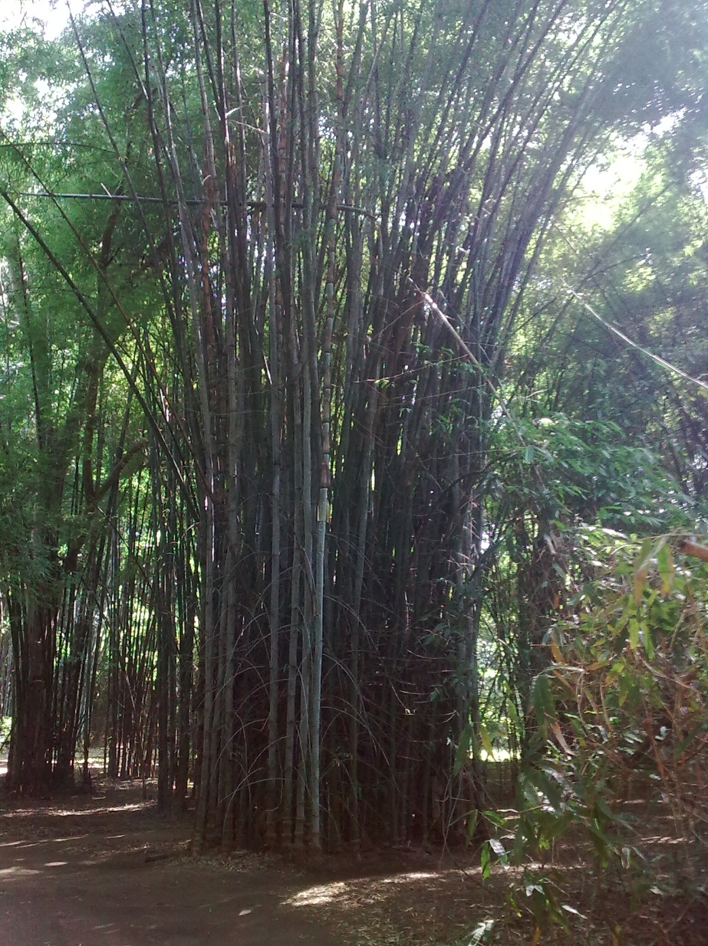

Sympodial Bamboos Monopodial Bamboos

Slide 61
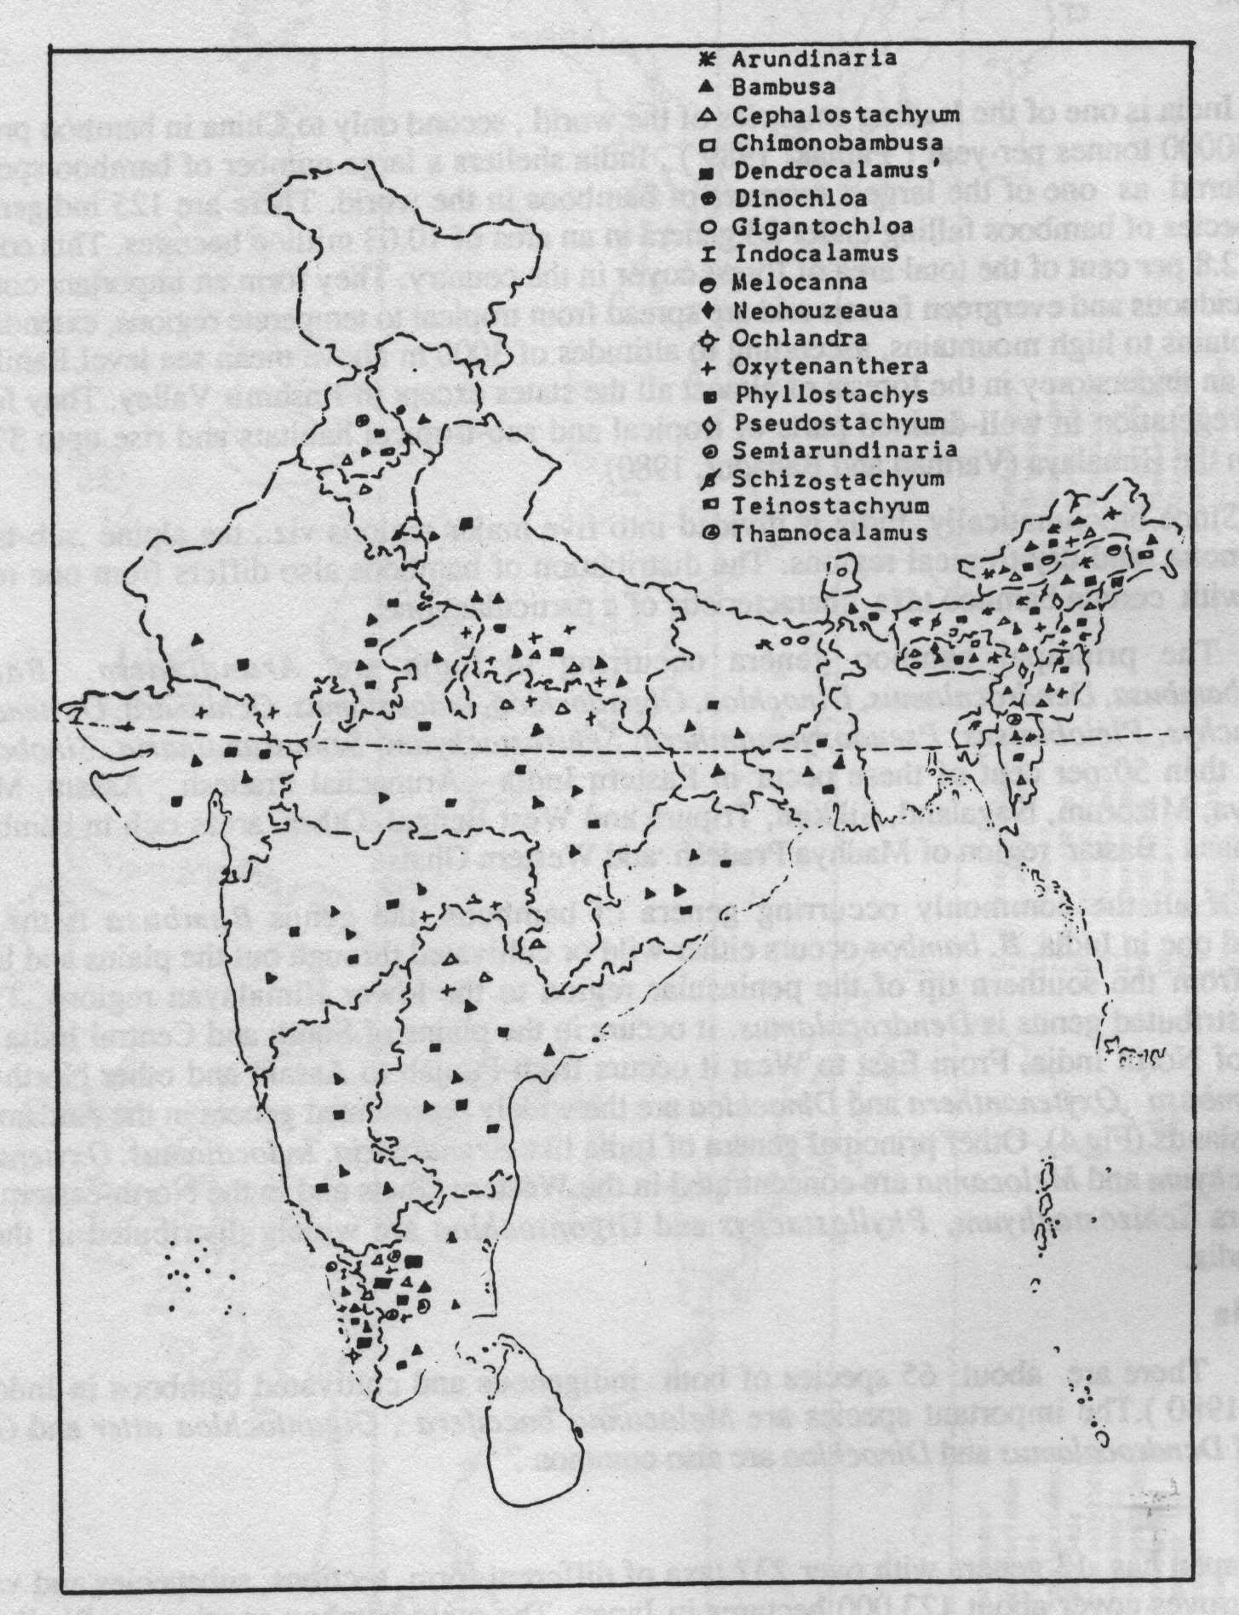
Distribution of Bamboos in India
D. Strictus 45%
M.baccifera 20%
B.arundeneria 13%
D.hamiltonii 7%
B.tulda 5%
B.pallida 4%
LAND AREA 328.7 M Ha
FOREST AREA 67.5 M Ha
BAMBOO AREA 8.96 M Ha
67% clump forming
33% non clump forming

Slide 62
Uses of Bamboos
Bamboo has more than 1500 documented uses.
  Food, Beverages
  Housing/Shelter
  Infrastructure
  Medicinal Uses
  Textile
  Recreational Uses
  Ecological Importance, Soil and Moisture Conservation etc.
  Handicrafts, Furniture
  Agricultural Implements
  Charcoal, Fuel
  Alternate Timber

Slide 63

BAMBOO HANDICRAFTS

Slide 64
















Slide 65









So many products…..
…..but which ones to choose?
Bamboo
Beer
Baskets
Charcoal
Bamboo
fabrics
Bamboo laminated
flooring and panels
Building products
Blinds
Ford concept car

Slide 66




Bamboo Shoots

Slide 67





Slide 68





Slide 69


Bamboo in Construction

Slide 70




Slide 71



Slide 72




Bamboo Cottage at PUSA, New Delhi

Slide 73

BO-OG NURSING HOME, OSLO

Slide 74


BEER SHAVE, ISRAEL
DG PUBLIC WORKS OFFICE, NETERLANDS

Slide 75

BAMBOO INFRASTRUCTURE
TRADITIONAL BRIDEGES

Slide 76


Slide 77

MODERN BAMBOO BRIDGES

Slide 78

MADRID INTERNATIONAL AIRPORT

Slide 79

Design of the new Bengaluru Airport Terminal – T2

Slide 80



Slide 81


Slide 82



Slide 83


Slide 84


Slide 85


Slide 86

千岛湖别墅
Qiandao Villadom in China
Qiandao Villadom in China

Slide 87

SOIL CONSERVATION WITH BAMBOO

Slide 88




Slide 89



Bamboo in Textiles

Slide 90




Slide 91








Slide 92



Bamboo Tissue Paper & Disposable trays / takeaway Food Trays

Slide 93

Bamboo Medical Tourism

Slide 94
BAMBOO & LIVELIHOOD
A Case Study of UBFDB, Dehradun
Resource development & Ecological conservation:
Plantation
Community Awareness Generation
Bamboo based Enterprise Development
Decentralized and centralized production
Supply-Chain
Infrastructure development:
Innovative product design, tools & technology research;
Bamboo housing
Rural enterprise development:
Handicraft diversification
Training for skill up-gradation
Marketing and handholding for rural producers and small entrepreneurs
Networking
Knowledge management for extension
with other agencies

Slide 95




Resource Development and Ecological Rebuilding
Ensuring supply of quality planting material
  Centralized nurseries – 15 Nos
  Women/Farmer nurseries and Rhizome banks – 15 Nos
  1 Million Plant Production capacity per year
Resource Development : Over 20000 hectares planted
  Ecological value
  Sustenance value
  Commercial Value

Slide 96



Awareness and Sensitization
- Stigma attached with bamboo growing
Campaigns through Electronic and Folk media
Workshops & Exposure visits.
One Stop Centers & Demonstrations.
Village level Meetings
Reached to about 40, 000 households

Slide 97



Training and Capacity Building
Trained / Capacitated over 3700 artisans on handicrafts, furniture, housing, nursery and plantation techniques, enterprise development, institution devt, etc
Intensive training for master trainers – 140 Nos (function as resource person for DRDA, IFAD, KVIB and other programs)

Slide 98






Enterprise Development - CFC

Slide 99




Promotion of Construction Enterprises

Slide 100




Institutions: Groups, Cooperatives, Federation and Companies

Slide 101



Marketing and Promotion
Has market outlet
Linkages with state Eco-Tourism Parks / Tourism Department for Souvenir
Branding
Establishment of marketing networking.
Participation in major trade fairs / National and international exhibition
Organizing Bamboo and Natural Fiber product expositions to showcase the products and develop linkages
Repeat Orders from Customers

Slide 102

Development of Bamboo in China
A Case Study
Value: >US$ 30 billion (2016)
Global Export Share: 70%
Employment: 8 million
Product types: >10,000
Coverage: >6 million ha
Standing culm: 28620000000
Species: > 500 - 40 genera
Carbon: 727.08 Tg (2010)
Sources: SFA 2012 & Chen et al, 2009
Anji County, Zhejiang Province, China

Slide 103
Evolutionary Stages of Development
Pre Industrial Processing
Industrial Processing
Rapid Industrial Development
Expansion period
Environment friendly products

Slide 104





1) Pre Industrial Processing: 1980-1985
Raw bamboo (bamboo culms) → fresh bamboo shoot, scaffolding; bamboo daily products (farm tools, bamboo mate, broom, bamboo basket); traditional paper; traditional furniture

Slide 105






2).Industrial Processing: 1986-1992
Bamboo mat →processed shoots →fresh bamboo shoot →bamboo curtain, chopstick →sticks → flooring → mat/curtain → plybamboo → construction board → processed bamboo pole → bamboo daily products /handicrafts → bamboo pulp → traditional furniture → medicine (words in red are new products)

Slide 106







3) Rapid Industrial Development: 1993-1998
Bamboo curtain →bamboo carpet →bamboo mat → floorings → processed shoots → bamboo fresh shoot → mat/curtain/ plybamboo → processed poles → daily products → chopstick → laminated furniture → bamboo-wood composite →handicrafts → charcoal/coal tar → bamboo pulp → flavone products → particle board → medicine

Slide 107






Expansion period 1999-2005
Bamboo Floor, bamboo curtain, bamboo carpet, decoration board, bamboo mate bamboo pressed panel, particle board, processed shoots, fresh shoots, laminated furniture, mat/curtain /carpet, plybamboo, fiber and textile products, bamboo daily products, processed bamboo pole, medicines, bamboo sticks (toothpick, chopsticks), bamboo leaves, veneer, handicrafts, scaffolding, charcoal and charcoal products (such as health products, medicine, pesticides)

Slide 108



5) 2006-now transformation to period of high quality and environmental friendly products
Decoration board, bamboo pressed panel, flooring with patterns on surface, pressed bamboo, particle board, processed shoots, fresh shoots, laminated furniture, bamboo mat/curtain /carpet, bamboo veneer, plybamboo, bamboo and PP composite panels, fiber and textile products, daily products, processed bamboo pole, medicines, bamboo sticks (toothpick, chopsticks), bamboo leaves, veneer, handicrafts, scaffolding, charcoal and coaltar products (such as health products, medicine, pesticides), bamboo biomass fuel pellets ,modern raw bamboo furniture, modern bamboo building and decoration.

Slide 109
FROM HUMBLE BEGINNINGS:
ROME WASN’T BUILT IN A DAY
Source: SFA 2012

Slide 110
Plans for Industrial processed products, bamboo forest area and forest road construction
Products | 2011 | 2015 |  | 2020
Shoots Fresh/Processed | 6.6 million tons/1.66 million tons | 9.83/3.44 | 111.2% | 13.24/5.30 | 50.1%
Panels | 2.5 million tons | 2.93 | 16.98% | 4.30 | 46.94%
Floors | 0.78 million m³ | 0.95 | 21.54% | 1.21 | 50.34%
Pulp | 1.52 million tons | 2.07 | 36.05% | 3.04 | 55.27%
Daily products | 2.64 million tons | 3.21 | 21.56% | 4.71 | 46.94%
Furniture | 6.75 million pieces | 9.18 | 36.04% | 12.88 | 40.26%
Fiber | 96,300 tons | 235,100 | 144.15% | 378,600 | 60.05%
Charcoal | 136,200 tons | 222,000 | 63.05% | 357,700 | 61.05%
Drinks | 17,425 tons | 68,872 | 295.25% | 138,526 | 101.14%
Bamboo area | 6.73 million ha |  |  | 7.73
Bamboo plantlets | 120 million plants |  |  | 500
Forest roads | 70,975 km |  |  | 174,641
Total production value | 117.3 billion RMB | 150 | 27.9% | 300 | 100%

Slide 111
History of bamboo industrialization in India
Sir William Raitt in 1923 lead the production of craft paper from Bamboo and commercialized it.
First Bamboo paper manufacturing factory was established with the technical support of Forest Research Institute (FRI), Dehradun at Orient Paper Mills, Brijnagar, Orrisa.
Till 1980 about 6 lakh metric tonnes of paper was being produced in India using upto 70% raw material obtained from bamboo by around 35-40 paper and pulp factories.
Manufacture of Rayon grade pulp was initiated at Gwalior Rayon Ltd. with the help of FRI, Dehradun.
FRI also developed techniques for bamboo laminations, bamboo ply, bamboo boards, bamboo cement reinforcement etc.
The Timber engineering department of FRI developed bamboo trusses and joinery systems used in constructions with bamboo that later on were also adopted by BSI for developing codes for bamboo.

Slide 112
Where we lagged behind
Not protecting natural regeneration of bamboo from fire / grazing.
No cultural operations done in forest bamboos.
No further innovating Research & product development.
Bamboo treated as forest product, not as a crop.

Slide 113
Possible Strategy for Further Development
Plan both vertical and horizontal policy action for each State as per market demand and skill of local human resource.
Identify the action / implementation strategy as per processing requirements of different end products (ecological, livelihood, industrial etc.)
Appropriate inventory of the species found in an area and approximate production values per year (in nos, tonnes, etc.)
Development of Bamboo cluster based on available resource (species) and skilled human resource, etc.
Linking the cluster with the nearest bamboo Special Economic Zone along with implementable plan for optimum utilization of bamboo industrial waste.

Slide 114
Bamboo needs to be treated as a crop and develop into different agro-forestry models to increase farmers’ income like done in Sindhudurg district of Maharashtra integrating Mango, Cashew nut plantations with bamboo.
Promote utilization of bamboo in horticulture (stakes / poles for apple, vegetables, polyhouse etc.), Animal husbandry, poultry, agro-packaging etc.
Constant and concurrent innovative research support required from different institutions and its dissemination to farmers like tools, agro-forestry models, increasing in productivity, product development/design etc.
Flexible financial incubation and support/ hand holding for the bamboo cluster.
Bring in conducive strategy for establishment of such industries that consume bamboo at bulk for the benefit of bamboo growers.

Slide 115




GOOD DAY

Slide 116
About us
Tanjun is a knowledge based, innovation driven organization working across the entire value chain of skill-development. The word Tanjun means simple or simplicity.
1
Tanjun owns and sustainably runs a Livelihood Skill Training & Research (LSTR) Centre in a profitable business mode to showcase success of it’s Rurban micro-enterprise models in Bamboo.
2
8 Persons core team
15 Additional project based persons
3
55 years of collective
experience in Bamboo
Tanjun is a linear, compact & efficient organization engaged in primary research and finding profitable uses for Bamboo
11 dedicated persons for this project
www.tanjun.asia

Slide 117
STEP-1
DEFINING THE FRONT END & CREATING A USAGE MAP
Handicraft
Handmade
Semi-Mechanized
Mechanized
Beauty & Wellness
Artifacts & Decoratives
Toys & Engagements
Jewelry & Wearables
Containers & Carriers (Kanwar)
Beauty & Wellness Products (Actichar)
Furniture
Exclusively Bamboo
Mixed Materials & Cladding
Traditional
Housing
Traditional Treatment
Joinery
Roofing
Prefab
Housing
Mechanized Treatment
Machined Bamboo
DOMESTIC MARKET EXPORT POTENTIAL
Engineered
Structures
Bridges
Security fencing
Scaffolding
Non-Housing
Large Products
Decorative Fencing
Garden Equipment & Fountains
Playground Equipment
Activated Charcoal
FURTHER DETAILING
OF EACH WILL BE DONE
Research
Initiatives
Bamboo-Themoplastic Composites
Bamboo Fabric
Bamboo Medicines

Slide 118
STEP-2
DEFINING THE BACK END & CREATING AVAILABILITY MAP
Availability of
Appropriate Cultivable Area
Strategy of the State
Bamboo Mission
PROXIMITY TO MARKET
WILLINGNESS OF FINANCIAL INSTITUTIONS
Distribution of
Species: Civil/Forest
POTENTIAL FOR INTRA-STATE
& INTER STATE MARKET GROWTH
Harvesting, Stocking
& Waste Usage
SKILL DEVELOPMENT POTENTIAL
OF THE STATE IN BAMBOO BASED
LIVELIHOODS
INTER STATE INTRA STATE
SUGGESTIVE LIST OF NATIONAL & GLOBAL
SKILL PROVIDERS
Manpower & Training
Potential of the state
LISTING OF MACHINE & TECHNOLOGY
SUPPLIERS: NATIONAL & GLOBAL
Logistical Support &
Movement Challenges
MAPPING OF INCENTIVES & SUBSIDIES
IF ANY FOR BAMBOO BASED LIVELIHOODS
Effect on Farming &
Existing Forest/Tribal rights

Slide 119













History of Multi-site Procurement
History of Training & Learning
History of Product development in Bamboo
History of Exhibitions & Events
Equipped for Research & Implementation

Slide 120




SINGLE STORIED HOUSING
PRODUCTS
Badriville Resort-Badrinathji

Slide 121





SINGLE STORIED HOUSING
PRODUCTS
Badriville Resort-Badrinathji

Slide 122





SINGLE STORIED HOUSING
PRODUCTS
Senalaya-Juleri-Rishikesh

Slide 123





SINGLE STORIED HOUSING
PRODUCTS
Tanjun Founder’s Outhouse-Dehradun

Slide 124





DOUBLE STORIED HOUSING
HOUSING
PRODUCTS
Badriville Resort-Badrinathji

Slide 125





DOUBLE STORIED HOUSING
PRODUCTS
Hotel Silver Arch-Mussourie

Slide 126





DOUBLE STORIED HOUSING
HOUSING
PRODUCTS
Tanjun Founder’s Home-Dehradun

Slide 127





CAPSULE HOUSING
PRODUCTS

Slide 128





MISCY HOUSING
PRODUCTS

Slide 129





OUTDOOR FURNITURE
PRODUCTS

Slide 130





FURNITURE
PRODUCTS

Slide 131



GAZEBO / VIEWPOINT
PRODUCTS

Slide 132





FENCING
PRODUCTS

Slide 133







HANDICRAFT
PRODUCTS

Slide 134





HANDICRAFT
PRODUCTS

Slide 135


LIGHTING FIXTURES
PRODUCTS
Made by the Bhil Tribal Children of Shivganga-Jhabua M.P.

Slide 136


Let us join our multiple resources to cross the bamboo bridge together
Bamboo Joints Developed by Tanjun & The Tanjun Bamboo bridge in Maharashtra
THANK YOU
& JAI HIND

